Slide 1

DEVELOPMENT PLAN OF
TKAK
2023 - 2027

Slide 2



3 facts from the past
The school was established in 2003 and it was aimed to offer an education to the youth without basic education aged between 15 and 17.
It was the wish of North Tallinn to get active and effective educational center named Kopli Vocational school as the result of reorganization.
When establishing the school, the district government was interested in the school becoming a comprehensive educational center aimed at preparing young people for life and providing high-quality professional training, which would certainly take into account the interests of the district's entrepreneurs when training staff.

Slide 3


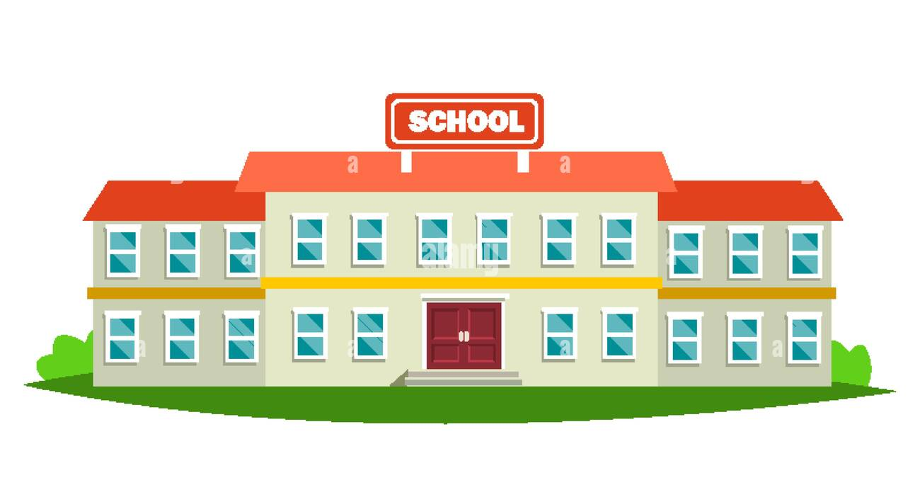

The school provides an education for students with special educational needs.
Bilingual school - Russian and Estonian.
Vocational education from 2nd to 5th level.
3 facts from the present

Slide 4



3 dreams for the future
Sustainable economy
Basic education, upper secondary education and vocational education
Internationalization

Slide 5



The only bilingual school offering vocational education in the administrative area of the city of Tallinn was established 20 years ago.
Primarily the focus was on young people without basic education.
Afterwards times changed and further education gained momentum.
The direction of teaching students with special educational needs has been added.

Slide 6



In near 20 years:
The development of the Kopli area has started.
The need to design an individual learning path over the entire life span has grown.
The expectations of employers in vocational training, workplace-based retraining and the needs of new era specialists are changed.

Slide 7




Revision of the strategy after today's councilors' entire mandate with regard to the future of employers and new professions.
The preparation of the new brand Kopli98 and also the launch of the school's image project, so that the school will be consciously in sync with the green capital and the development of education quality at the age of 20.
What do these changes mean for our school?
Adaptation of the offered studies for smooth movement between types and levels of education, which would encourage us to grow into a competence center.
Basic renewal/development of a sustainable image of all study areas and curricula and "breathing together" with the culture and heritage of the community.

Slide 8






DESIGN & IMPLEMENTATION OF SUSTAINABLE VOCATIONAL EDUCATION
ADMINISTRATOR & EXECUTIVE OF CONTINUING EDUCATION
DEVELOPING THE COMPETENCIES IN ACADEMICISM OF MICROLEARNING
INTEREST EDUCATION IN COMMUNITY SERVICE
ACADEMIC NETWORKS & CROSS STUDIES WITH UNIVERSITIES
IN ORDER TO:
WE INVOLVE EMPLOYERS IN DESIGNING THE NEED FOR THE FUTURE JOBS
WE STAND FOR THE QUALITY OF STUDY WORK
WE CREATE A SUSTAINABLE LEARNING SPACE AT THE SERVICE OF THE NEW AGE LEARNER

Slide 9
Do we get the green light?

